Slide 1

1
-SAM- Simplified Access to Markets
Team ea$y$: Chester Choy, Chun Jing Hui, Francine Tan, Joshua Wong, Tan Hui Qin

Slide 2
2
Introduction and Problem Definition
Rise of Technology
Financial Literacy amongst Youths
Increased access to the Internet and mobile devices
Increased spending on credit
1/3 of young adults are deemed ”financially precarious” due to lack of financial literacy
Rise of digital/mobile banking and self-services
Expansion of online banking services due to COVID-19
2/5 of young adults struggle to stick to a savings plan
Need for a solution that taps on technology to improve the financial literacy of youths
Notes:
Importance of tech
Why people do not want to invest/online investments (stats)
What can our product do - Aim to achieve …..
Run through the solution architecture (ss/vpc and what we have done there)
Click through the sites
Investment should be a lifelong journey, want to simplify things as core business
Find out more, simulation, how keywords can be integral to as an investor, empower young investors
Conclude: show appreciation for marcus, we want to leverage on it to enhance outreach, core competency, simplicity → proposal wont be standalone, synergise everything

Slide 3

6
Proposed Solution
Overview
SAM: Simplified Access to Markets
Leveraging on the ubiquity of online banking services, we aim to solve the problem of the lack of financial literacy amongst youths by simplifying investments.

Slide 4

Proposed Solution
SAM
How to use?
1. Identifying client goals
2. Setting a suitable timeframe
3. Capital input for investment
4. Product Recommendation
5. Log in/Sign up
6. Interactive Dashboard

Slide 5
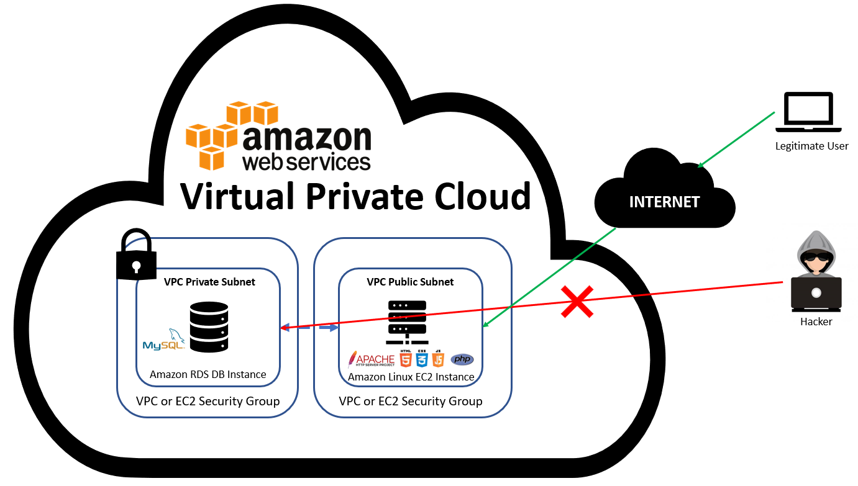
Solution Architecture | Technologies & Frameworks
Notes:
For our solution architecture, we created a VPC with both public and private subnets, hosting the web server in the public subnet and the database in the private subnet. This allows the apache web server to connect to the MySQL DB instance because it is hosted within the same VPC without making the DB instance available to the public Internet. By doing so, this enhancing security, which is crucial especially for a financial services product.
Note: DB means database

Slide 6
Product Demonstration
SAM
URL: http://ec2-18-140-60-54.ap-southeast-1.compute.amazonaws.com/app/2_goals.html

Slide 7
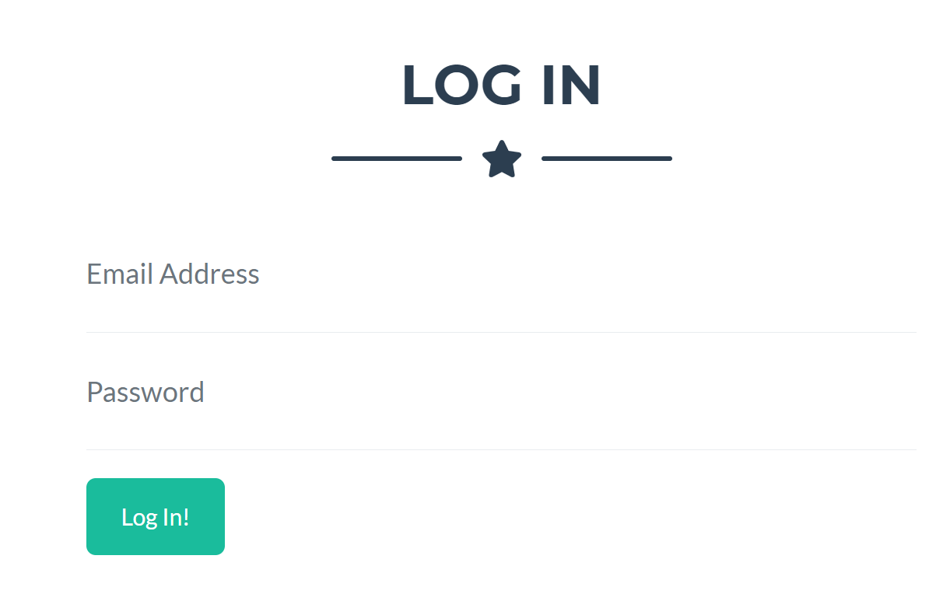
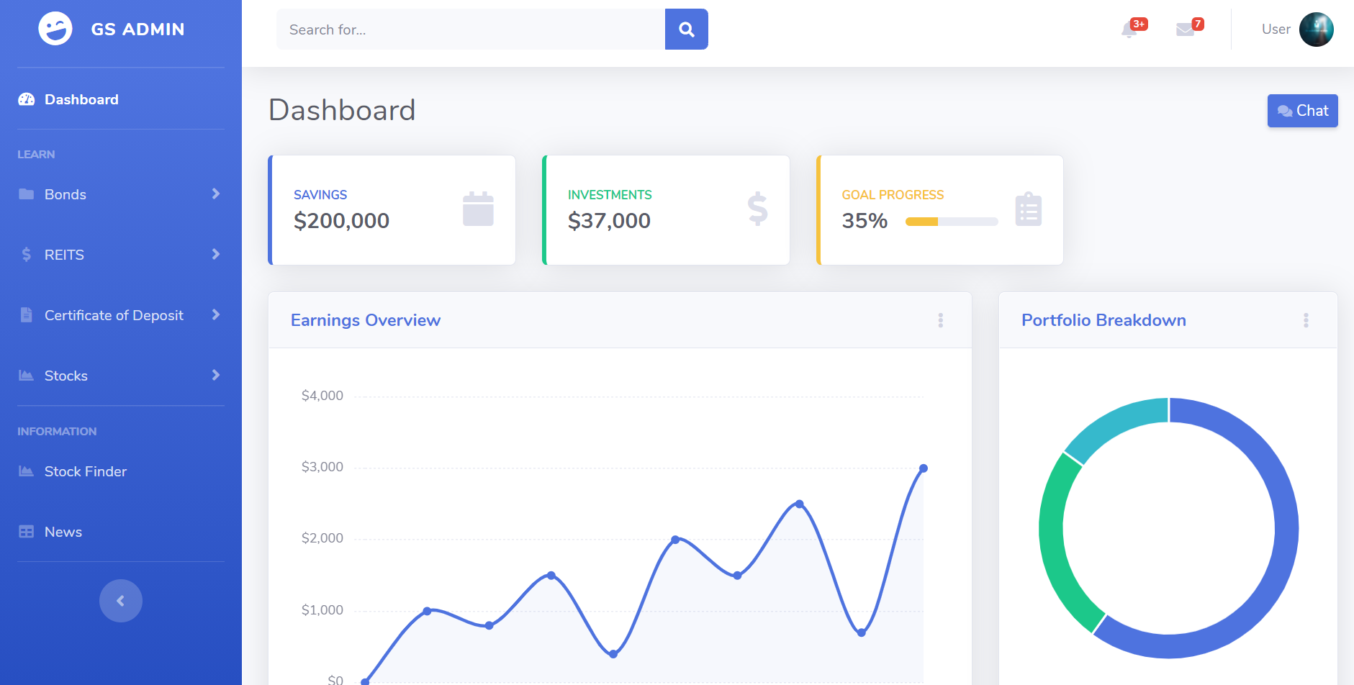
Product Demonstration
SAMPLE
Email Address: maytan@gmail.com
Password: abcdefg123

Slide 8
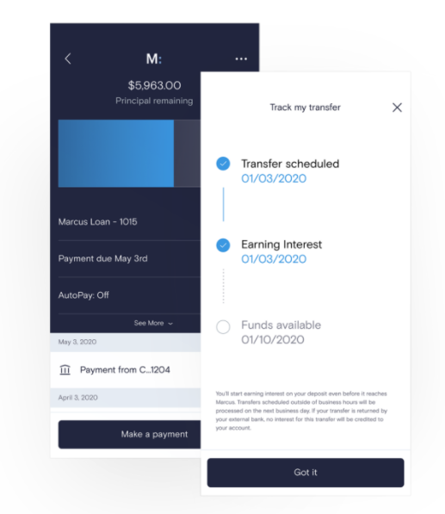

Additional Information (Potential Venture)
Marcus by Goldman Sachs
Leveraging on existing technology – Marcus
1. Simple and secure sign-in from Marcus to view real time simulations in SAM
2. Streamline applications on SAM for investments and make payment directly from Marcus
3. SAM synthesises and reports financial information and current interest rates pertaining to specific asset class
"With a simplified access to markets, we are here to help you make the most of your money"
Notes:
Conclude: show appreciation for marcus, we want to leverage on it to enhance outreach, core competency, simplicity → proposal wont be standalone, synergise everything

